Slide 1
AUXILIARY LEGAL ISSUES WORKSHOP
AVOIDING STORMS IN THE LEGAL OCEAN
2012 DTRAIN
District 7 Fall Training
Presented by
Braxton Ezell, ADSO-LP 7

Slide 2
Learning Objectives
Overview of Legal Issues Affecting Auxiliary Members.
Legal Protections While Assigned To Duty.
Offers of Use.
Auxiliary Contracts.
Elected Leaders Responsibility.
Donations and Solicitations.
Unit Standing Rules.
Administrative Discipline.

Slide 3
Legal Status of the Auxiliary
The Auxiliary is a non-military organization established by Congress and administered by the Coast Guard. 14 U.S.C. s. 821.
The Auxiliary is a component of the Coast Guard and is a federal agency.
The Auxiliary is NOT a 501(c)(3) organization.
The CGAuxA, Inc. is a 501(c)(3) corporation authorized by the Coast Guard to manage the fiscal affairs of the Auxiliary National Board.

Slide 4
References
Auxiliary Manual COMDTINST M16790.1G
Chapter 5, Section A. Public Law Excerpts
Federal Tort Claims Act - 28 U.S.C. Sections 2671 - 2680
Military Claims Act - 10 U.S.C. Sec. 2733
Admiralty Extension Act - 46 U.S.C. Sec. 30101
Public Vessels Act - 46 USC Chapter 311
Chapter 5, Section J. Assignment to Duty

Slide 5
References
Auxiliary Operations Policy Manual, COMDTINST M16798.3E.
Chapter 2. Section A. Orders
Chapter 2, Section B. Operational Training
Chapter 2. Section D. Mishap Reporting, Damage Claims, and Personal Injury

Slide 6
Government Benefits and Protection
May include:
Medical coverage,
Reimbursement for personal property loss,
Survivors’ benefits, and
Insulation from personal liability for injury or damage to a third party and/or property.
Caveat - No “coverage” guarantee.

Slide 7
Assignment to Duty
Assignment to duty is the critical, essential requirement for an Auxiliary member’s eligibility for Federal statutory benefits and protection while performing an “authorized” Auxiliary mission.
Member must not only be assigned to duty but must also qualified for duty (i.e., currency maintenance, mandatory workshops, etc.).
When assigned to duty, member is considered as a Federal employee.

Slide 8
Assignment to Duty
Member assigned to duty must be acting within the scope of federal employment to be legally protected and be eligible for benefits.
In the event of an incident coverage is decided on the facts and circumstances in each case .
Most likely will have coverage during authorized Auxiliary mission including en route to and from the place of the mission (excluding to and from flotilla meetings and social events).

Slide 9
Assignment to Duty
Schedule an official MT session for each Flotilla meeting and give prior notice of the MT session to Flotilla members.
A possible means of establishing a legal basis to en route coverage (i.e., that the member was en route to a MT session--not merely to a Flotilla meeting).
Consider combining Auxiliary official business with social functions.

Slide 10
Orders
In the event of an incident, the strongest evidence that the Auxiliarist was acting within the scope of employment is something that demonstrates that his or her assignment to duty was made prior to the incident in question.
Coast Guard orders,
verbal authorizations documented via a telephone log, or a written memo, or
e-mail to appropriate elected or staff officer.

Slide 11
Orders
Two kinds of Coast Guard Orders issued to Auxiliarists.
Orders for Facility Movement issued by Coast Guard OIA.
Orders Issued to Individuals by CG for duty assignments such as operational, logistics, or training support.
Specific Auxiliary activities may also be considered “assignment to duty”. AUXMAN, Chapter 5, Section J. Table 5-1.

Slide 12
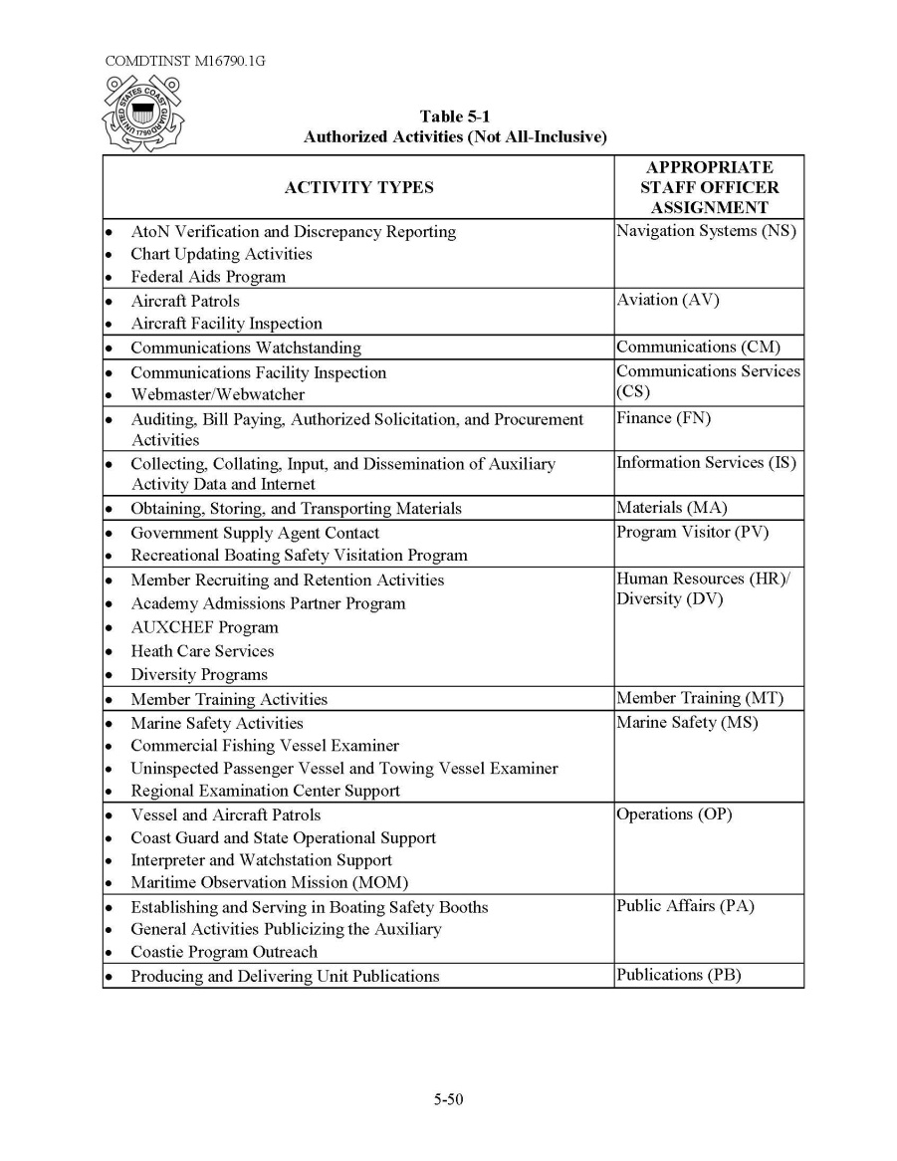
Table 5-1

Slide 13
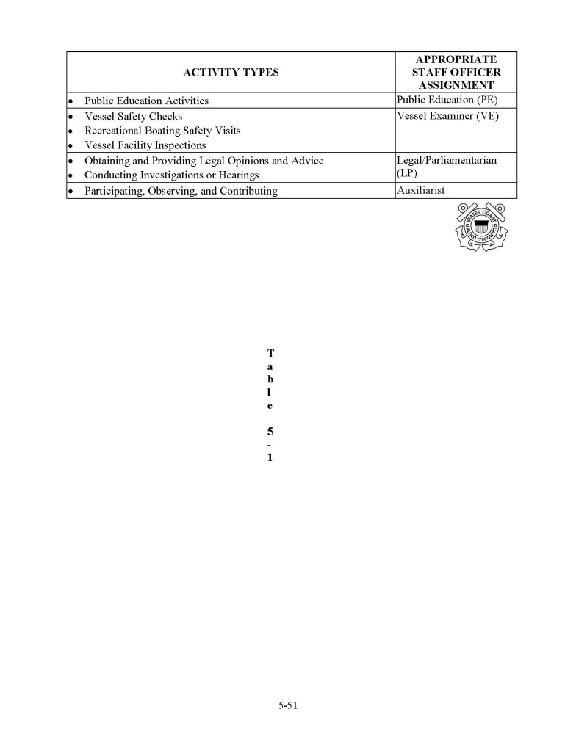
Table 5-1 Continued

Slide 14
Orders
The elected unit officers and appropriate staff officer for a particular mission or activity has assignment to duty authority.
Flotilla: Only the FC, VFC and the appropriate FSO for a particular mission or activity (e.g., the FSO-VE for a VE mission) has assignment to duty authority.
The assignment to duty at the flotilla level should always be scheduled in writing.

Slide 15
Offers of Use
Form 7003 VESSEL FACILITY INSPECTION AND OFFER FOR USE FORM should be filled out completely and accurately.
Use the most current version, Rev 001 dated June 2011.
In the case of multiple owners of a facility, all of the Auxiliary owners must sign the appropriate Offer for Use Form.

Slide 16
Offers of USE
Non-Auxiliarists who are joint owners of the facility must sign an Assent and Authorization Form.
Auxiliary Ops Pol Manual (COMDTINST M16798.3E), Ch. 1, Sec. B Facility Ownership.

Slide 17
7003

Slide 18
Assent & Authorization for Use

